Slide 1
Lesson objective
Title: Reflection fluency
Aim:
Reflect shapes across a mirror line
Create 3D shapes and draw their orthogonal views
Plan:
Review
Reflection practice
Orthogonal views

Slide 2

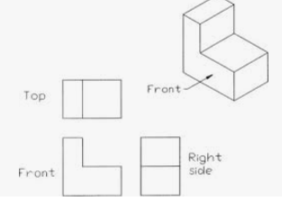
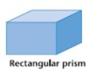
Types of view

Slide 3
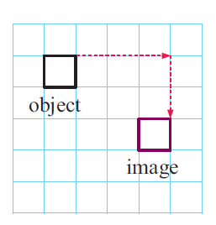
Daily review
TPS 35 seconds:
Translation is just a ________
Describe the movement of the square

Slide 4
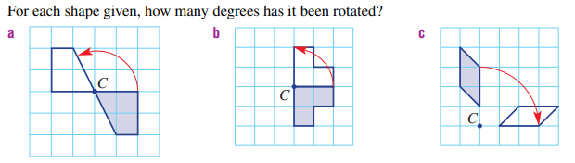
TPS

Slide 5
Reflection is just a flip
Lines of symmetry are the centre lines of symmetrical shapes
The lines are also called mirror lines
Vertical lines of symmetry
Horizontal lines of symmetry
Reflection can also occur outside of an object.

Slide 6
4
3
3
4
4
3
3
4

Slide 7
Reflection practice
Design a logo pg. 104 Exercise C.

Slide 8
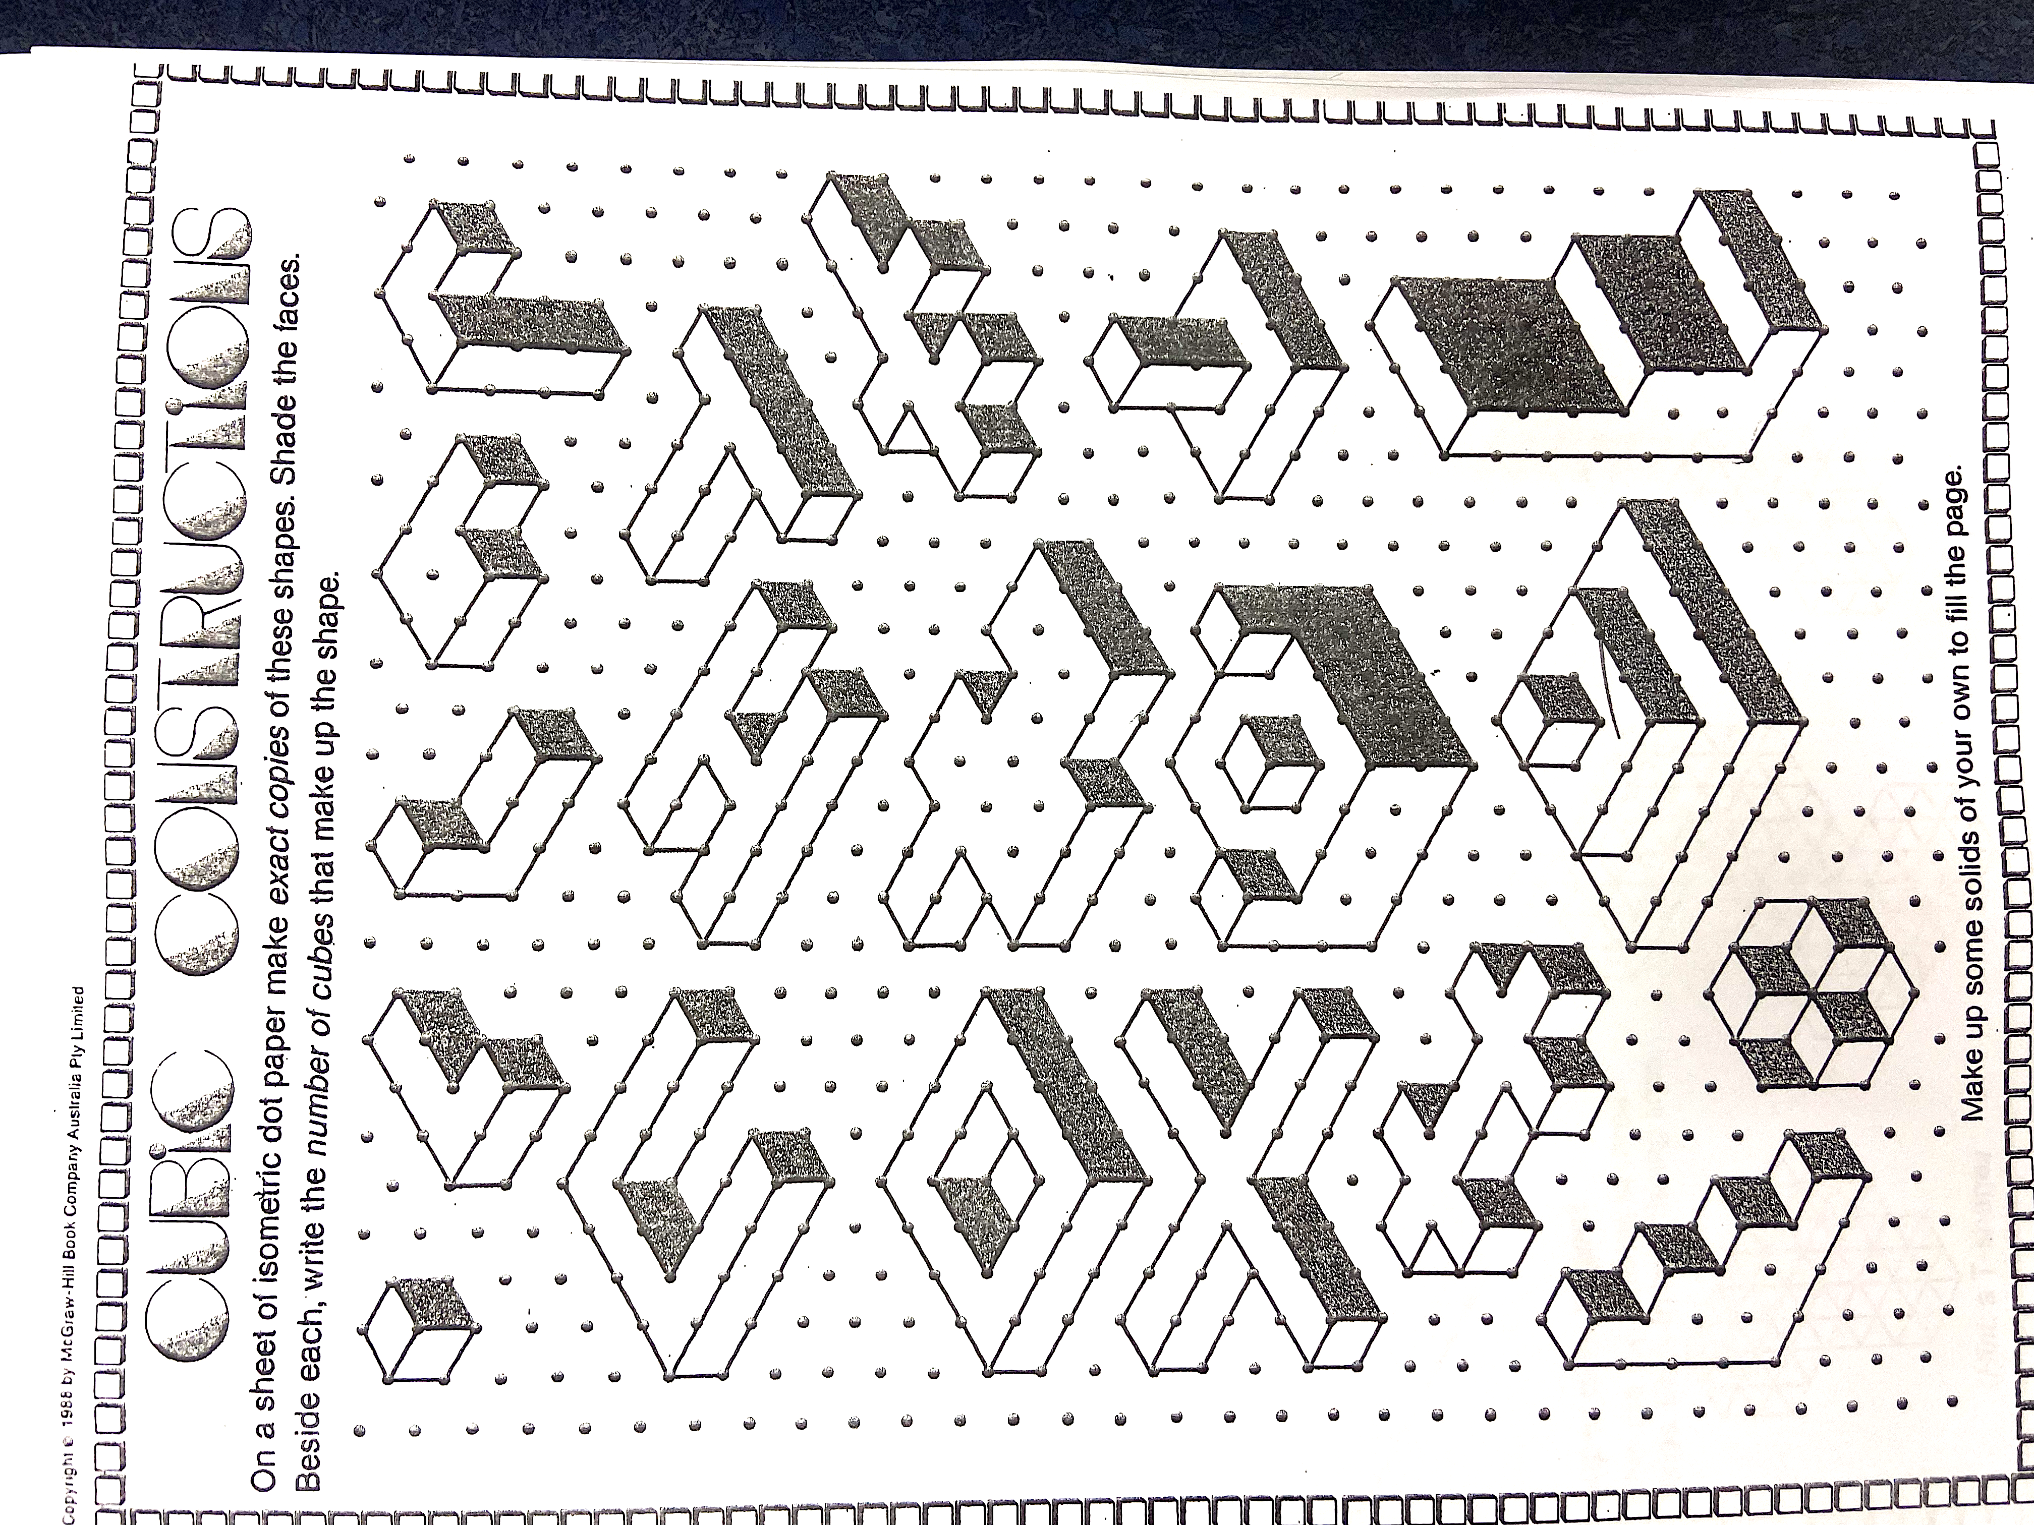
Cubic Constructions
Create the shape with blocks
Draw the ORTHOGONAL view on grid paper
Draw on isometric paper
Then rotate, translate or reflect (or all 3)

Slide 9
Cubic Constructions
Copy the following shapes onto your isometric dot paper

